Slide 1
FLOOD PREDICTION
-Presented by
K.Yellam Naidu
Ch.Pavya Sree
Ch.Dhana Lakshmi
Ch.Pravallika
G.Deepika

Slide 2
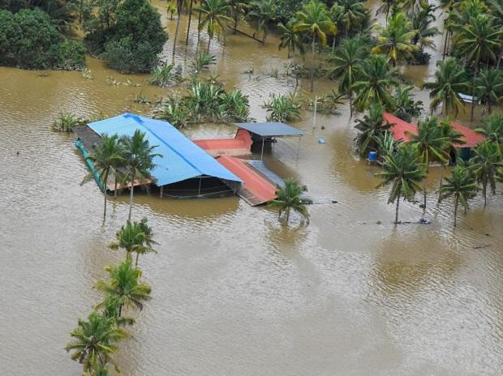
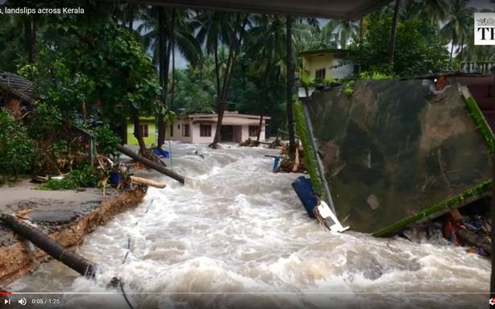
Introduction
Floods are the most destructive natural disasters which are highly complex.
The research on flood prediction has been contributing to risk reduction ,minimising loss of human lives , and reducing the property damages associating the floods

Slide 3
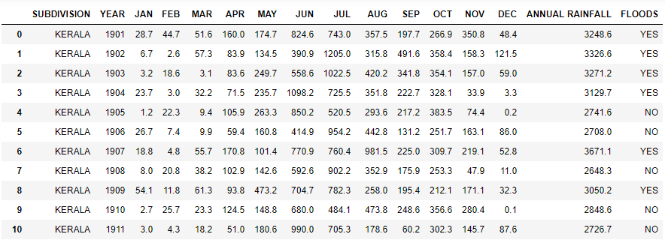
To minimize the complexity of mathematical expressions ,we are using machine learning methods for predicting the floods.
In the flood prediction data set we have considered fourteen predictors(rainfall rate for different months) and one target (floods).

Slide 4
Contents
CLASSIFICATION MODELS
1.KNN Classifier
2.Logistic Regression
3.Support Vector Classification
4.Decision Tree Classification
5.Random Forest Classifier
Barplot

Slide 5

KNN CLASSIFIER
K-nearest neighbours is a simple algorithm that stores all available cases and classifies new cases based on a similarity measure based on distance .It works on the principle of Eucledian distance formula.

Slide 6

LOGISTIC REGRESSION
Logistic regression is the appropriate regression analysis to conduct when the dependent variables are binary.
Logistic regression is a predictive analysis , it is used to describe the data and to explain the relationship between one dependent binary variable and one independent binary variable

Slide 7

SUPPORT VECTOR CLASSIFICATION
Support Vector Classifier is a supervised machine learning algorithm which can be used for both classification and regression .
SVM has a feature to ignore outlier and find the hyper-plane that has maximum margin.

Slide 8
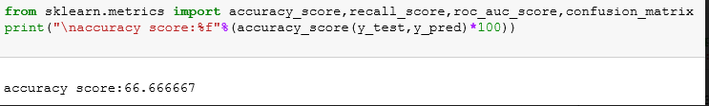
DECISION TREE CLASSIFICATION
Decision tree is a flow chart like tree structure where a internal node represents features or attributes and the branch represents decision rule and each leaf node represents the outcome . The topmost node in a decision tree is known as root node.

Slide 9
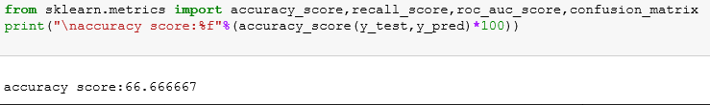
RANDOM FOREST CLASSIFICATION
Random forest classifier creates a set of decision tree from a randomly selected subset of training set.
Random forest builds multiple decision trees and merges them together to get a more accurate and stable prediction

Slide 10
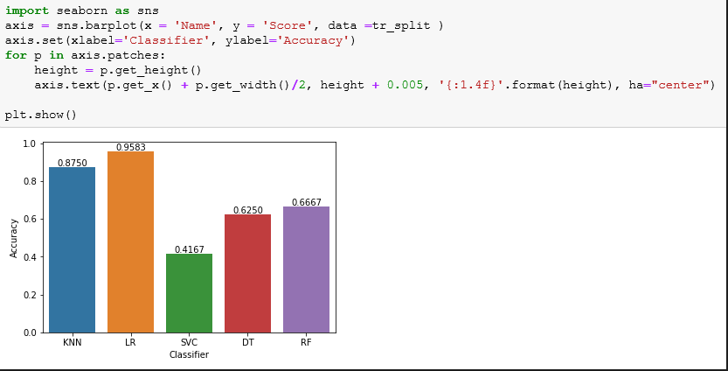
BARPLOT
From the barplot we observed that the accuracy value in logistic regression is high as compared to other classification models

Slide 11
CONCLUSION
Floods impact on both individuals and communities, and have social, economic, and environmental consequences. The consequences of floods, vary greatly depending on the location and extent of flooding, and the vulnerability and value of the natural and constructed environments they affect.
Depending on the data we collected, by using Machine Learning we can predict the occurance of flood. So that we can take measurements in order to reduce the effect of floods.

Slide 12
REFERENCES
1.WilliRichert and Luis Pedro Coelho “To get the knowledge about
machine learning using python”
2.https://www.coursera.org/learn/machine-learning-with-python
3.https://www.datacamp.com/tracks/machine-learning-with-python
4.https://www.geeksforgeeks.org/introduction-machine-learning-
using-python
5.RaulGaretta,GuillermoMoncecchi “this book is used for learning
scikit-learn.
6.https://www.drivespark.com/off-beat/kerala-floods-details-facts-

Slide 13
THANK YOU

